Slide 1
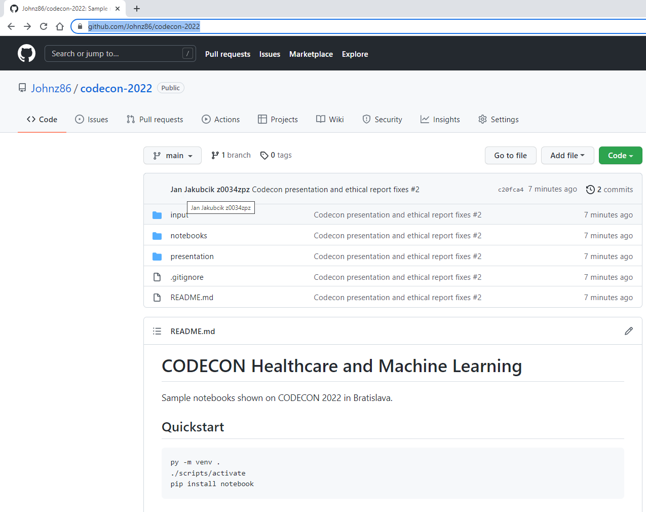
https://github.com/Johnz86/codecon-2022
Curated jupyter notebooks
& Presentation

Slide 2
Practical know how from projects
Healthcare and Machine Learning
Ján Jakubčík <jan.jakubcik@siemens-healthineers.com>

Slide 3
Practical examples that feed us.
The boring complex stuff that we have to do

Slide 4
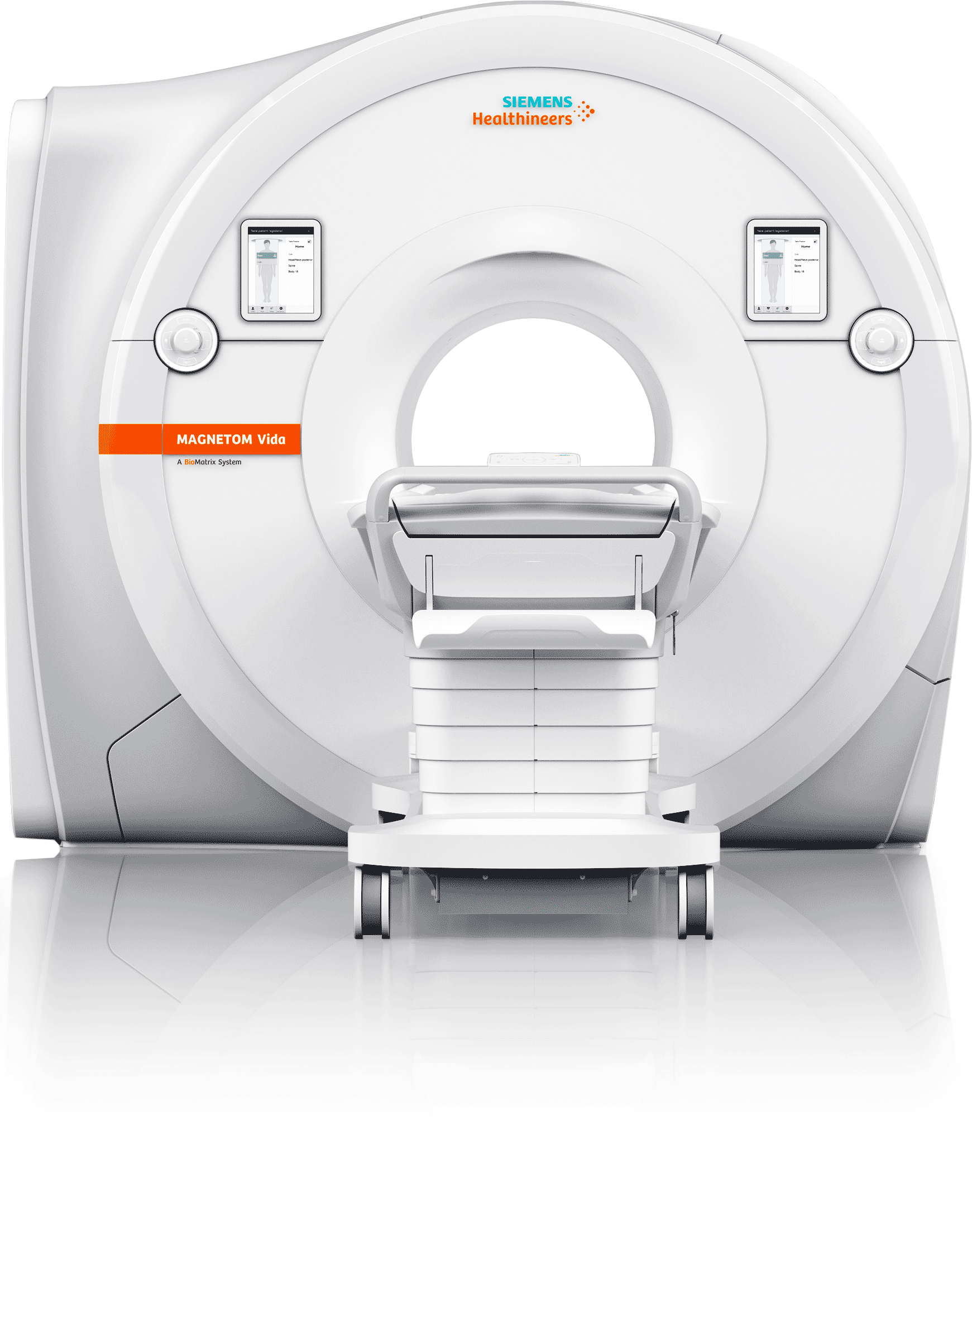
MR, CT, SU, Ultrasound
Software for Medical Devices

Slide 5
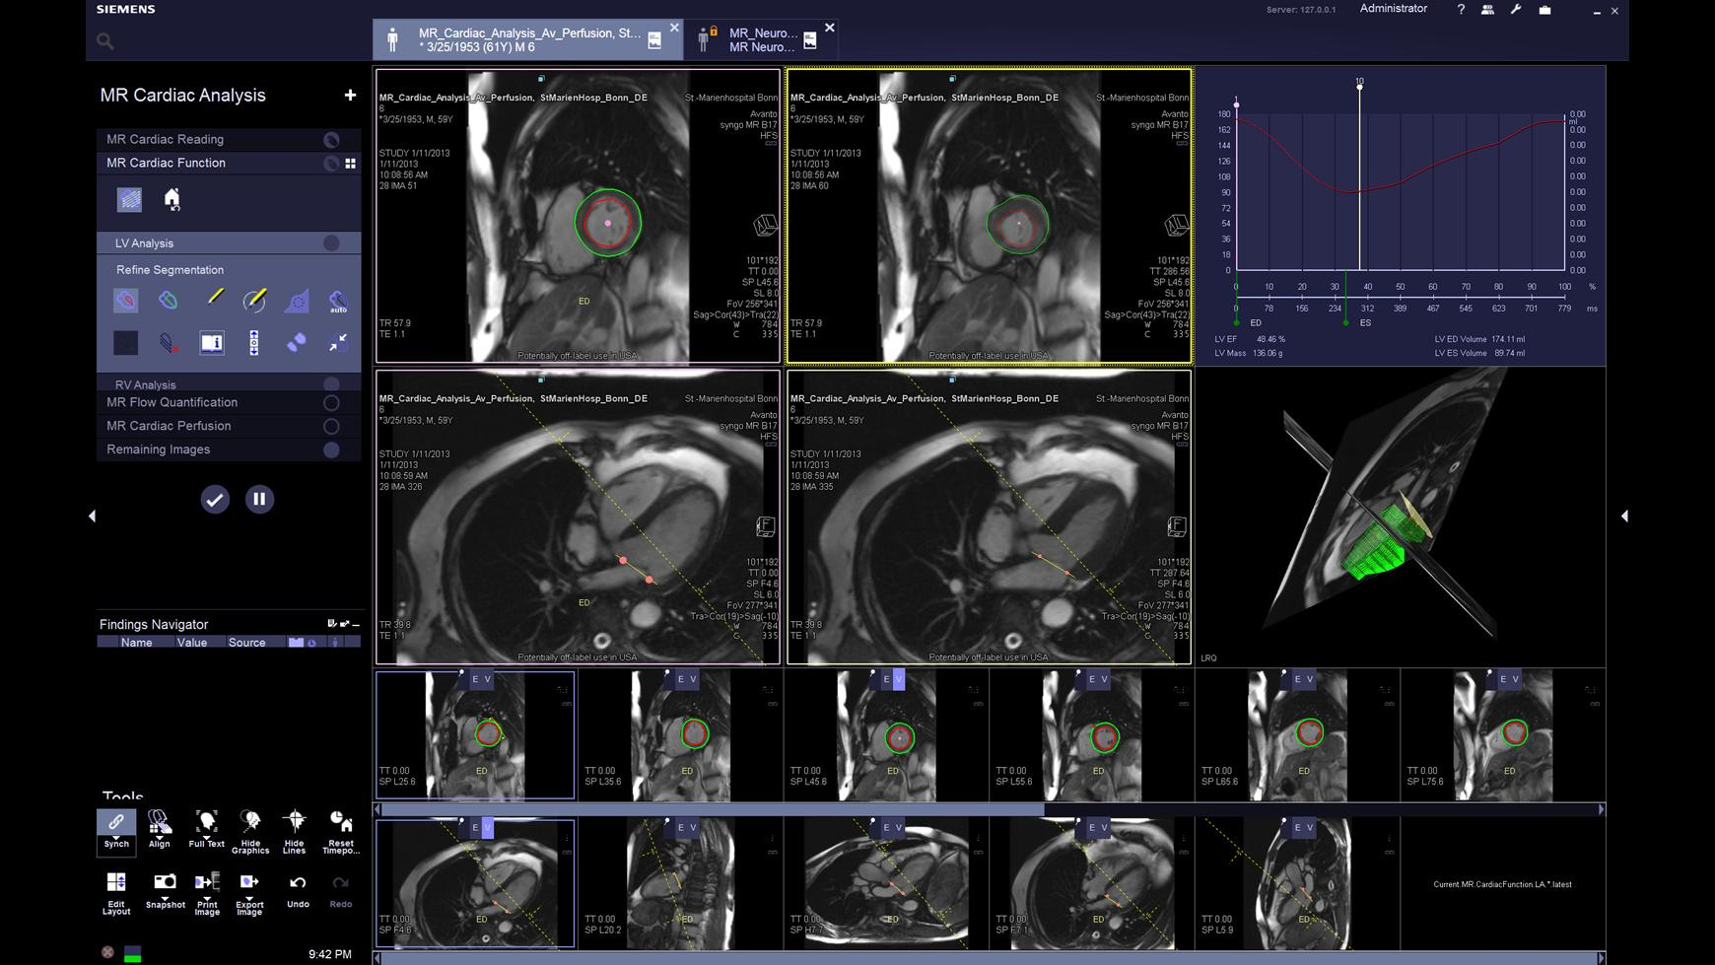
Syngo Software for Medical Modalities

Slide 6
Practical examples that we sell.
Cool Stuff That We do

Slide 7
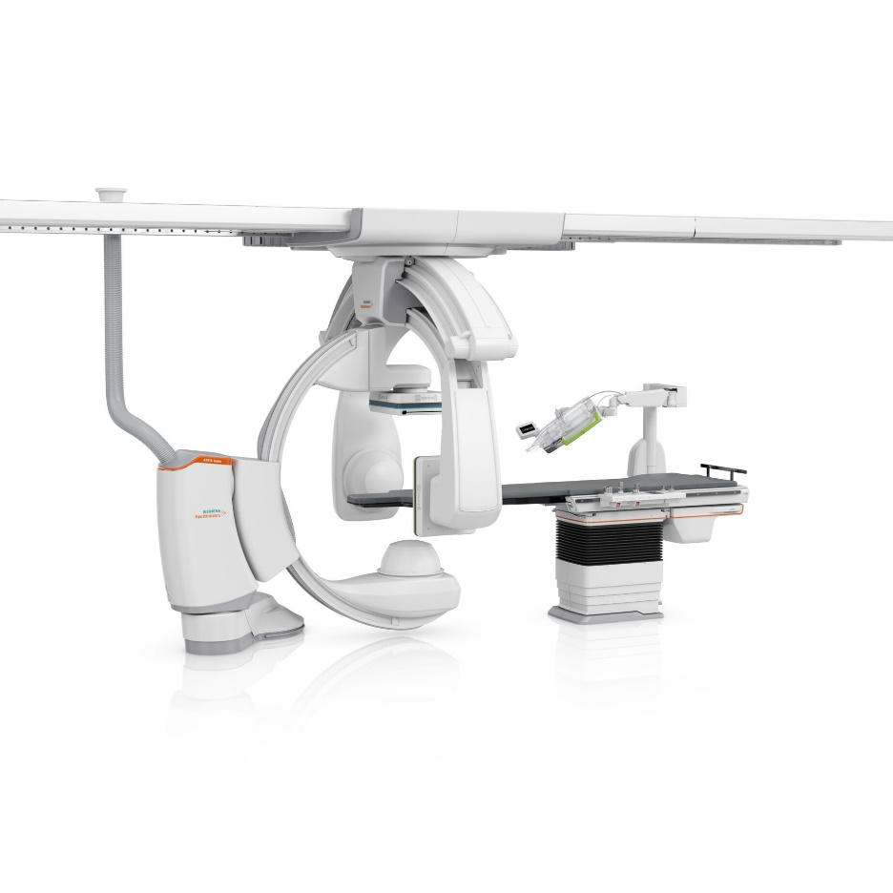
CorPath® GRX Neurovascular Robotic System and ARTIS icono
Robotic-assisted treatment of cerebral aneurysms

Slide 8
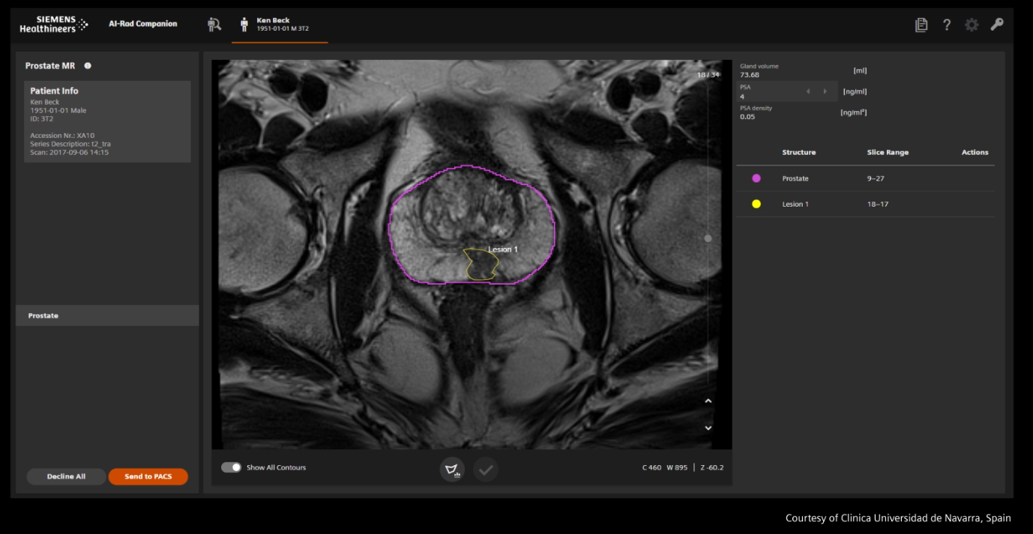
AI Related Stuff
AI Rad Companion
Zero Click Reconstruction
Laboratory diagnostics
Varian Cancer Treatment
And others…

Slide 9
Research and greenfield development
The stuff that I do.

Slide 10

Flare risk prediction during tapering biologic DMARDs
Rheuma Care Manager
Jakubcik, Jan (SHS DC SVK IT PRS1)
The animation of the dot pulse can be optionally switched off.
Go to Animations > Animations Pane.
Restricted © Siemens Healthcare GmbH, 2018

Slide 11
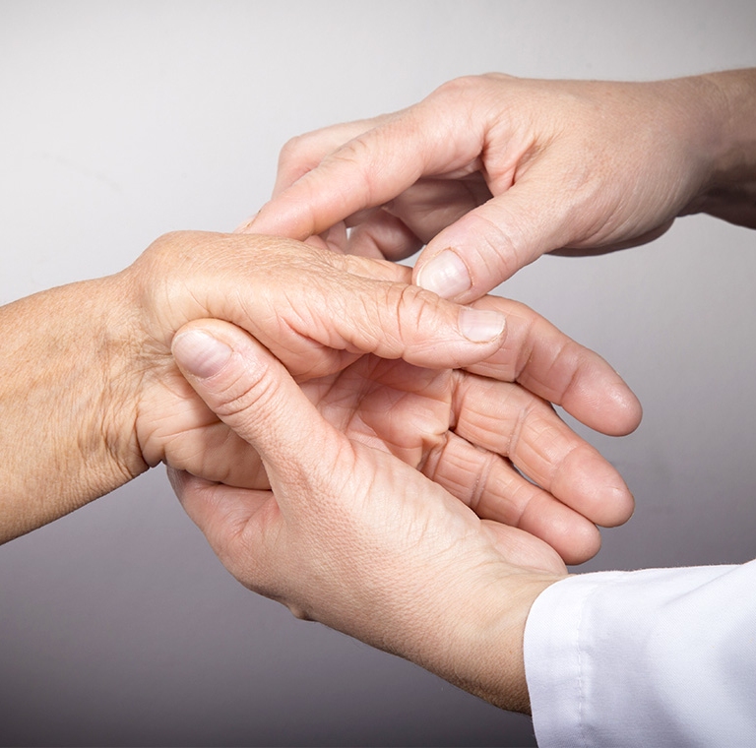
Feedback evaluation for prototype application focused on drug dosage reduction
Prediction of negative future events

Slide 12
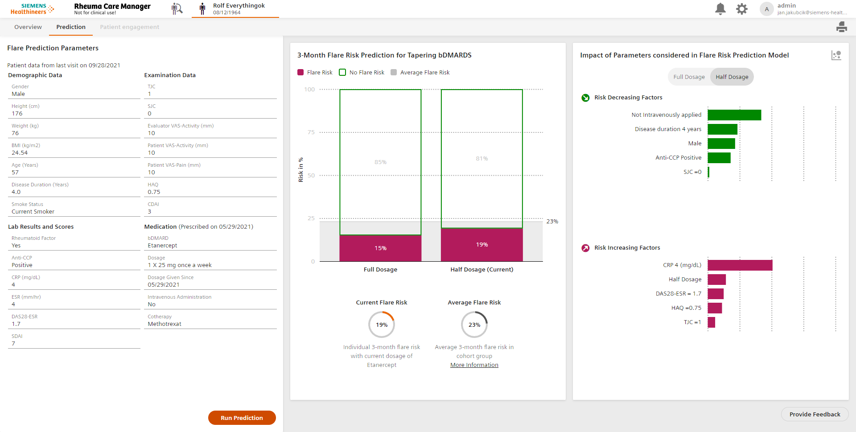
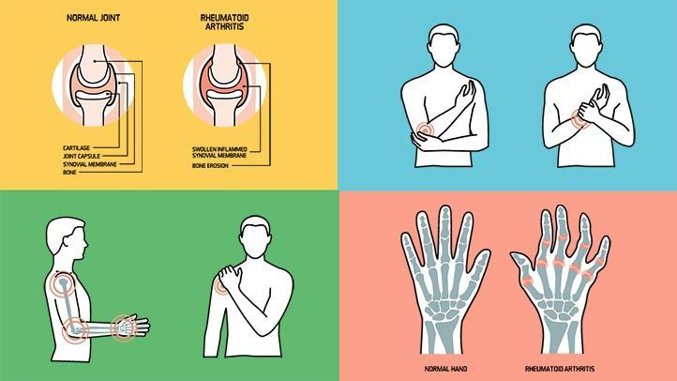
Rheuma Care Manager
Autoimmune and inflammatory disease.
Immune system attacks cells in patient body.
Causes inflammation (painful swelling).
Affects joints, most commonly in the hands, wrists, and knees.

Slide 13
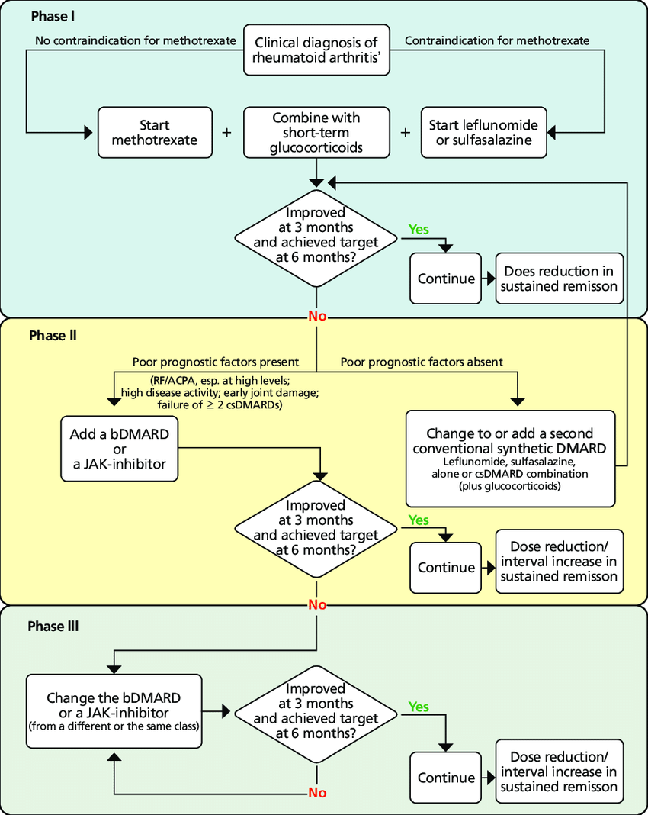
Recommended treatment with EULAR standard
Treatment in second and third phase of disease is very expensive and has sever side effects.
Efforts to reduce dosage of consumed drugs to save costs and improve health is standardized with EULAR process.
Prediction model for probability of severe side effects (flare risk) in 3 months period after this tapering process (drug dosage reduction).

Slide 14
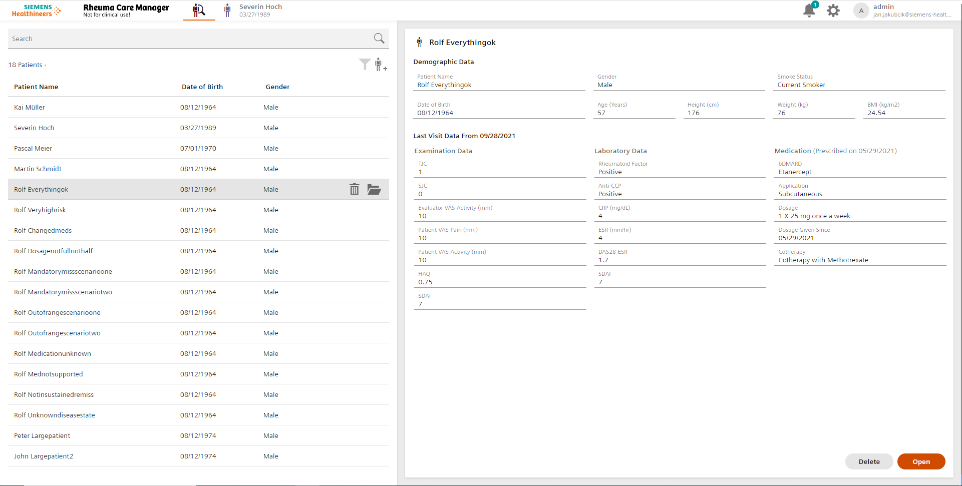
Pick a patient

Slide 15
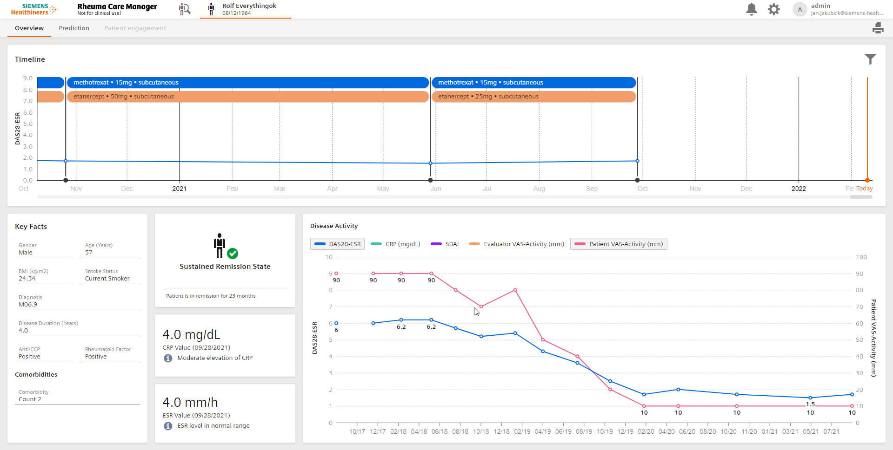
Overview patient history and disease state

Slide 16
Evaluate flare risk prediction and staircase graph explanation

Slide 17
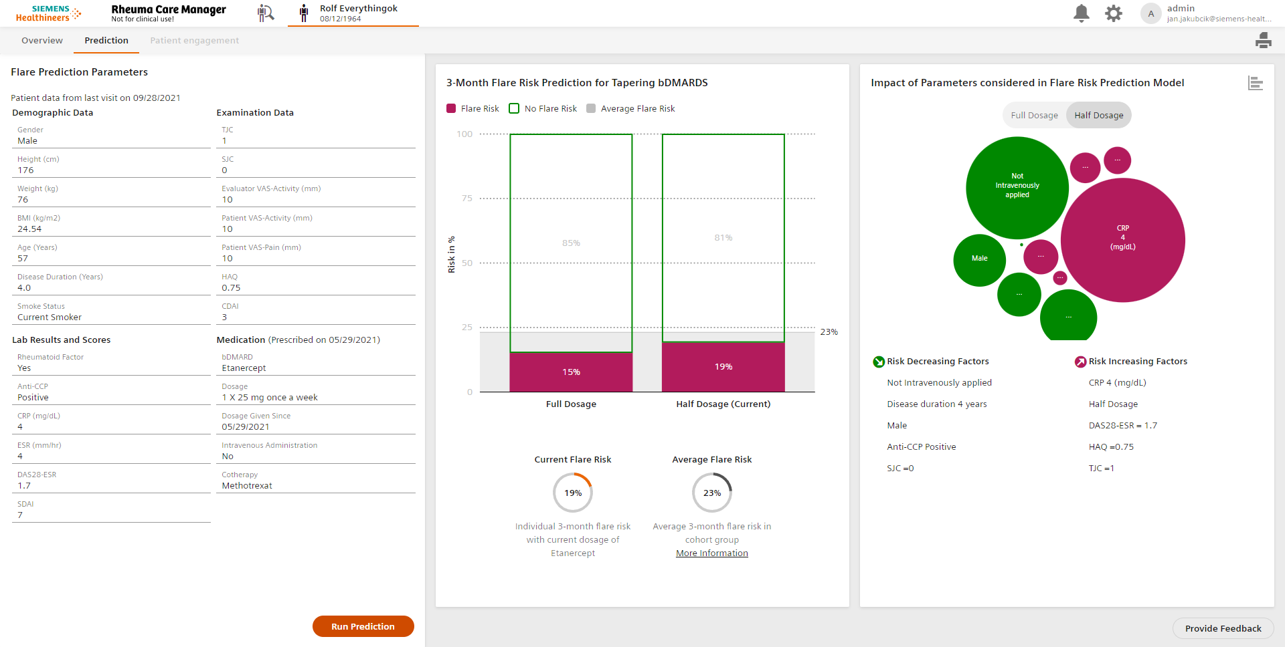
Evaluate flare risk prediction and bubble graph explanation

Slide 18
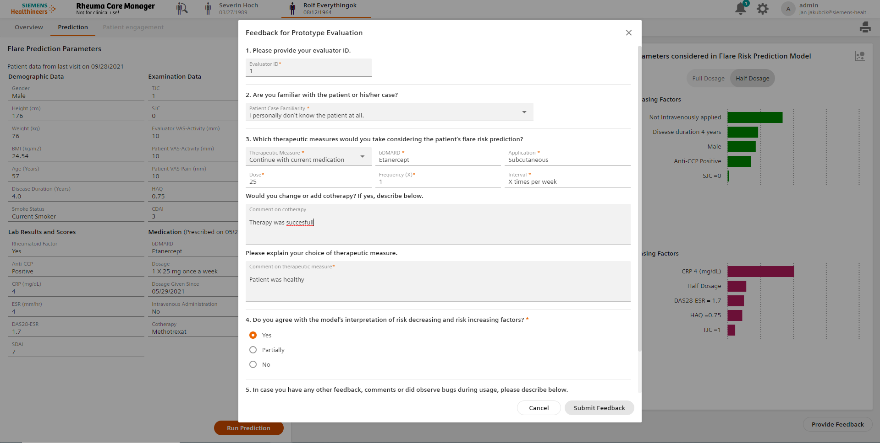
Feedback collection for flare risk prediction

Slide 19
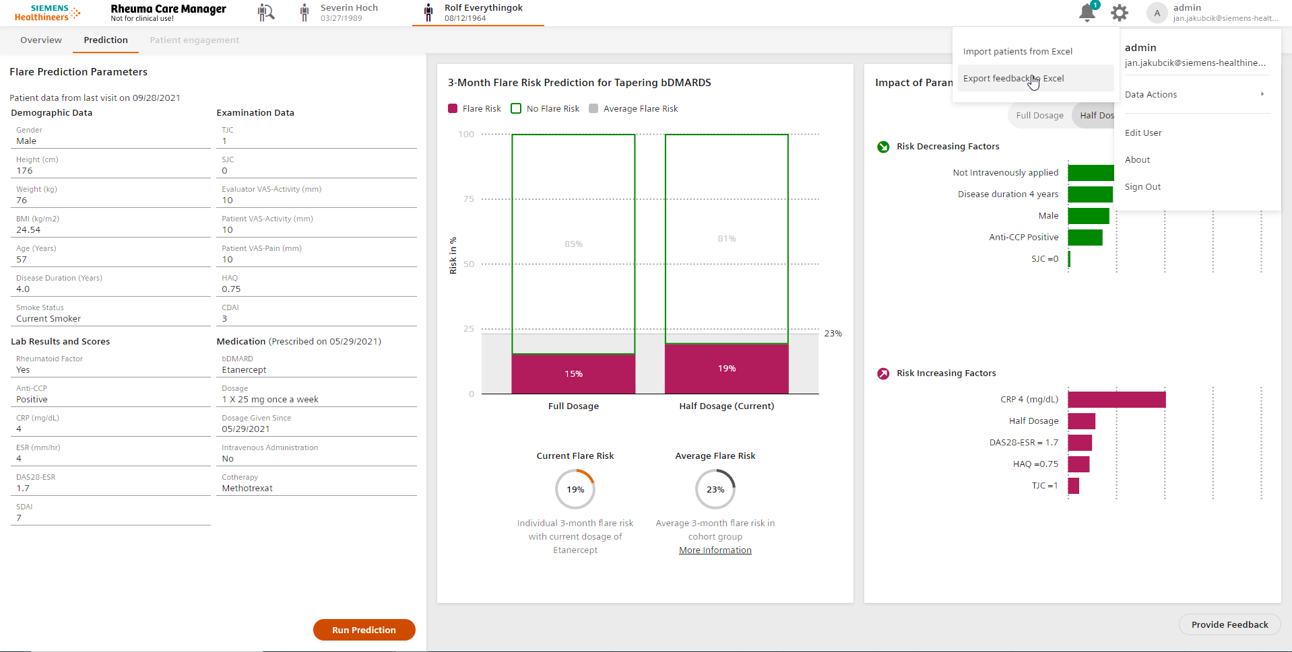
Over 6 months period verify validity of the model and usability of the application
Export collected feedback

Slide 20
Links
Original Research
[1] Vodencarevic A, Tascilar K, Hartmann F, et al. Advanced machine learning for predicting individual risk of flares in rheumatoid arthritis patients tapering biologic drugs. Arthritis Res Ther. 2021 Feb; 23 (67).
[2] Haschka J, et al. Relapse rates in patients with rheumatoid arthritis in stable remission tapering or stopping antirheumatic therapy: interim results from the prospective randomised controlled RETRO study. Ann Rheum Dis. 2016 Jan; 75(1).

Slide 21
Lessons Learned
Acquisition of data
Integration to hospital environment
Usability of model outcome
Model explanation
Ethical reports
Quality documentation for authorities
Legality and production process

Slide 22
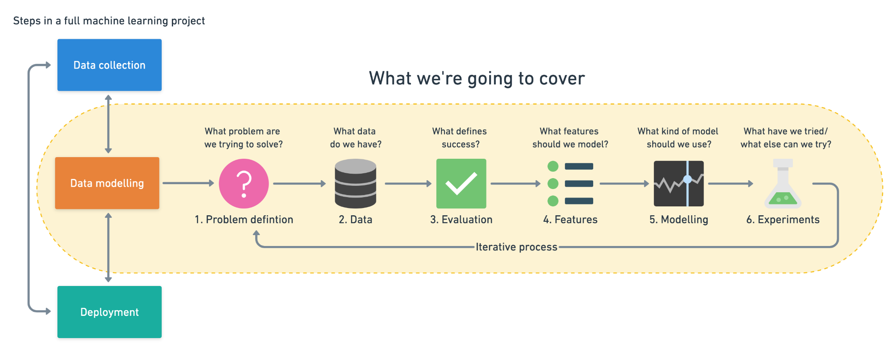
Standard Machine Learning Process

Slide 23
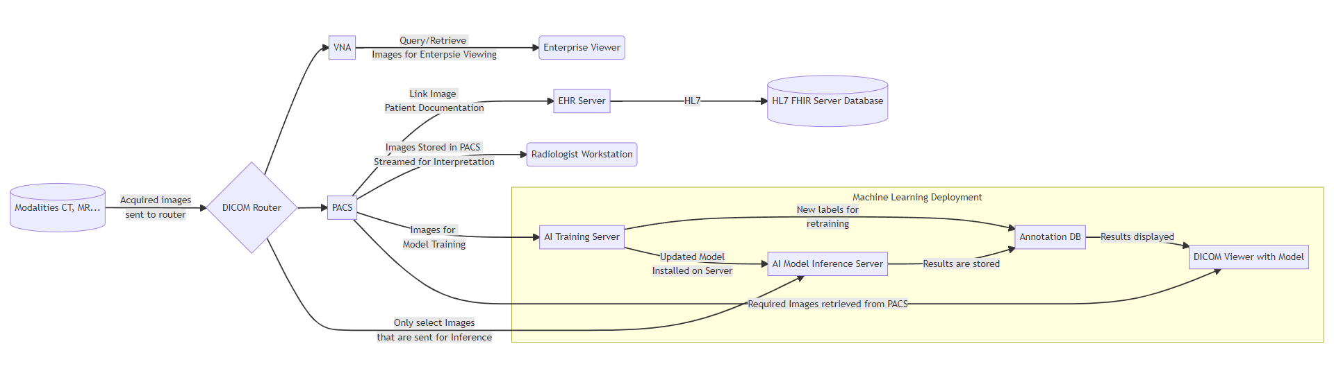
Machine Learning Ops and Medical Environment

Slide 24

MONAI Core
PyTorch-based framework for deep learning in healthcare imaging used to create state-of-the-art, end-to-end training workflows.
MONAI Label
Medical image labeling and learning tool that enables you to create annotated datasets and build AI annotation models quickly.
MONAI Deploy
tools to design, deploy, verify and analyze the performance of AI-driven applications in the healthcare domain.

Slide 25
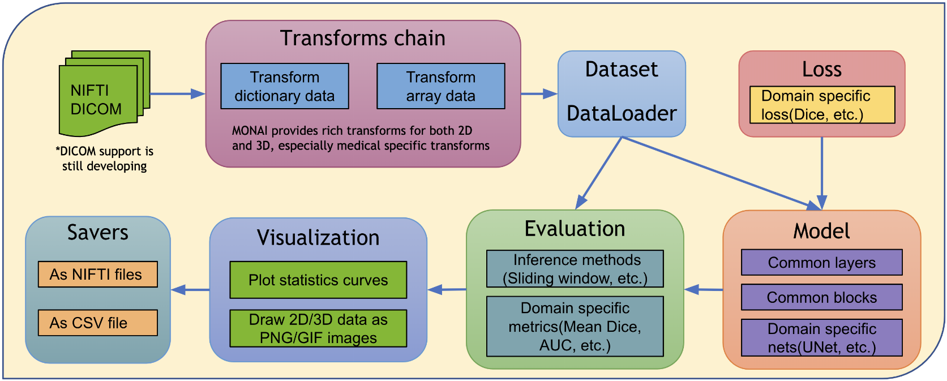
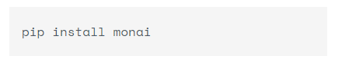
Machine learning for healthcare imaging
MONAI Core

Slide 26
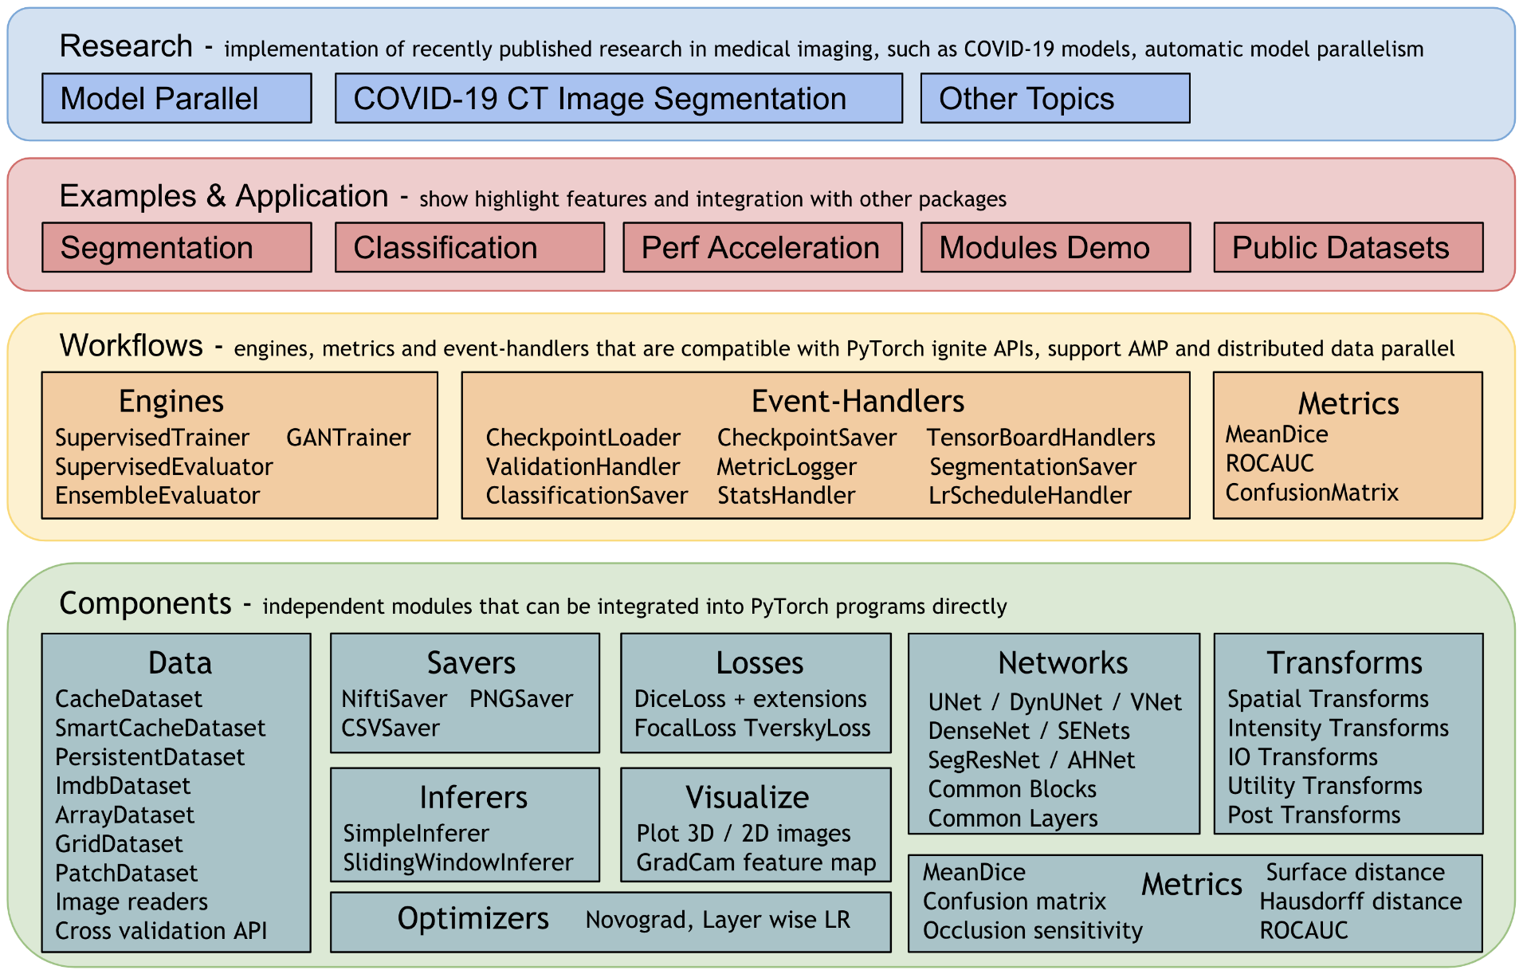
MONAI features

Slide 27
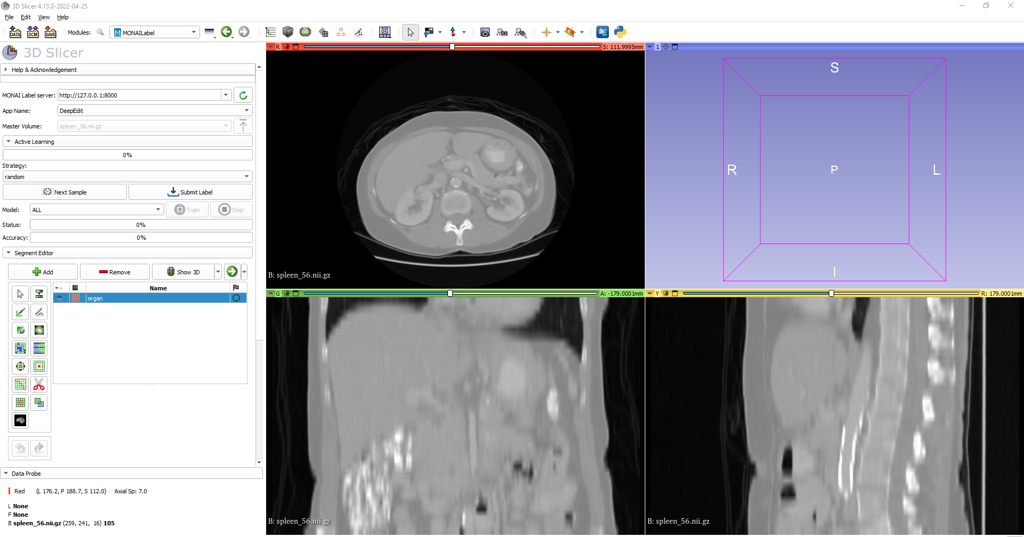
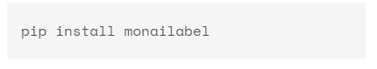
Label medical images and model inference
MONAI Label

Slide 28
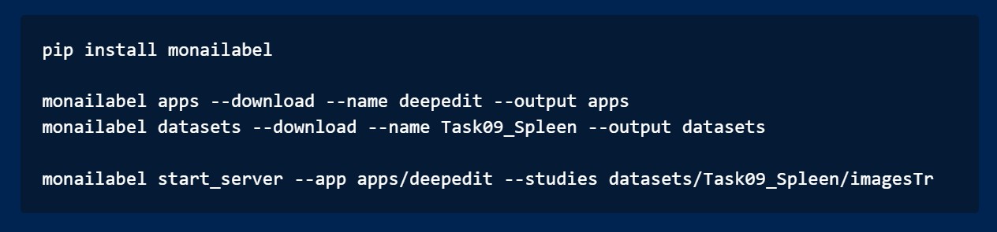
MONAI Label Basic Steps

Slide 29
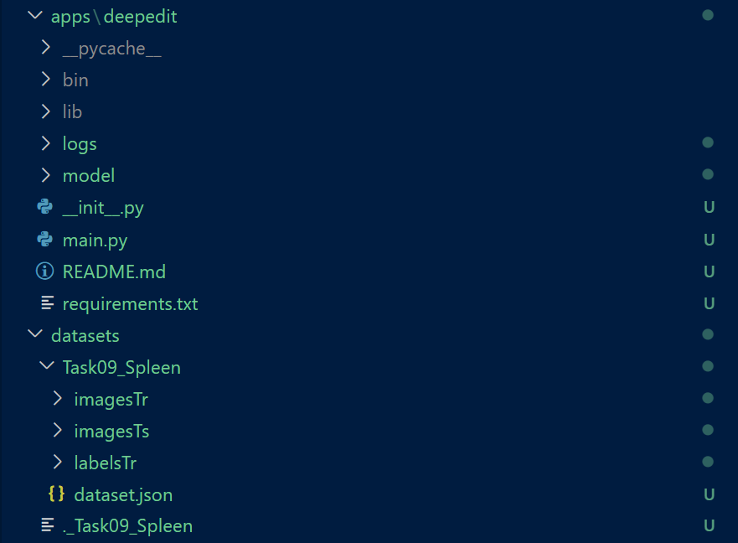
MONAI Label Downloaded Files

Slide 30
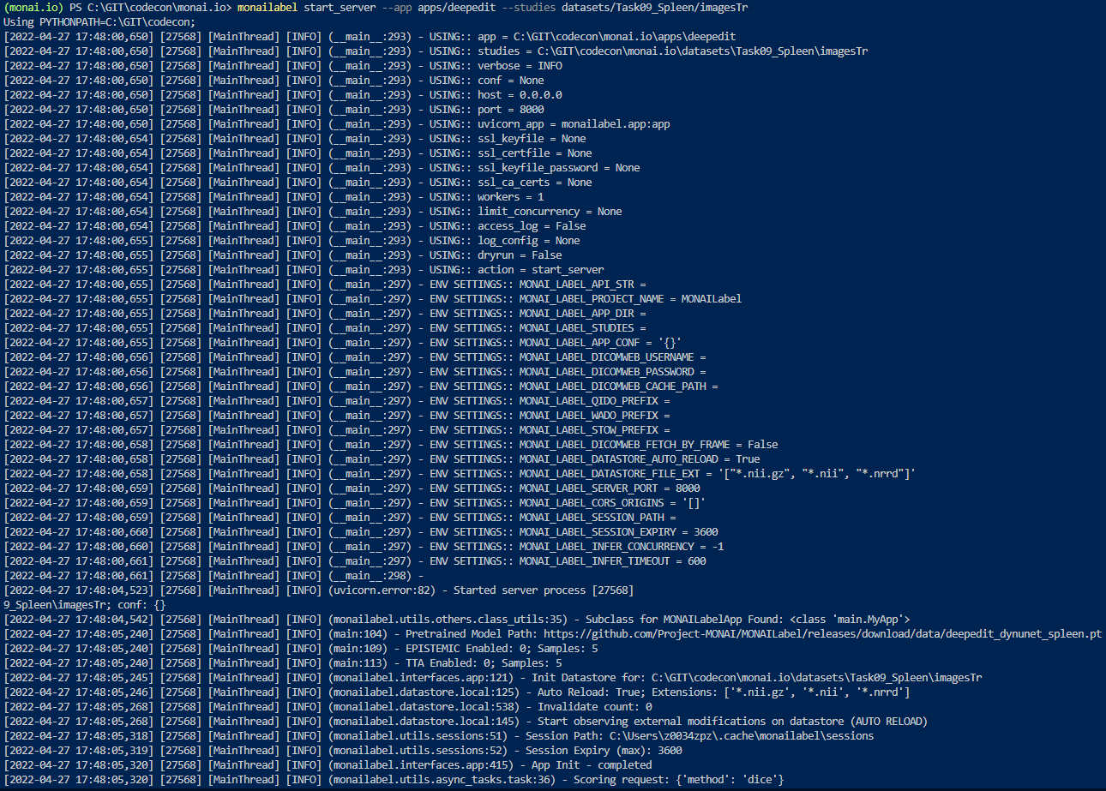

Slide 31
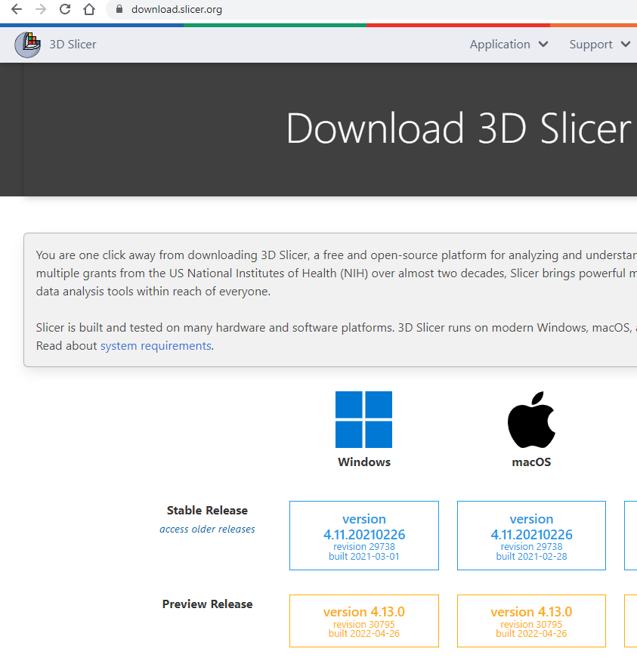
Free app for labeling and model inference https://download.slicer.org/
3D Slicer

Slide 32
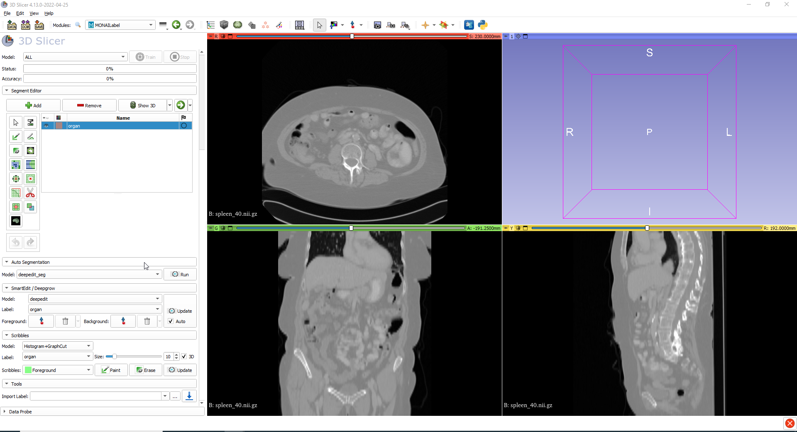

Slide 33
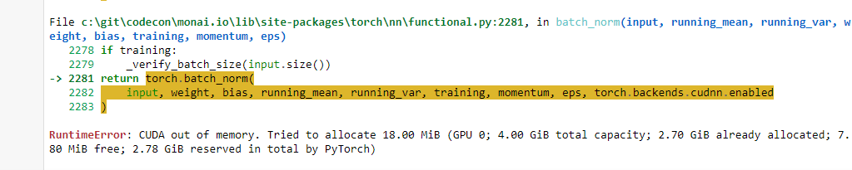
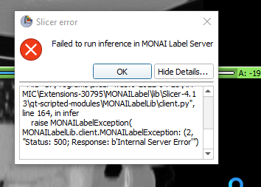
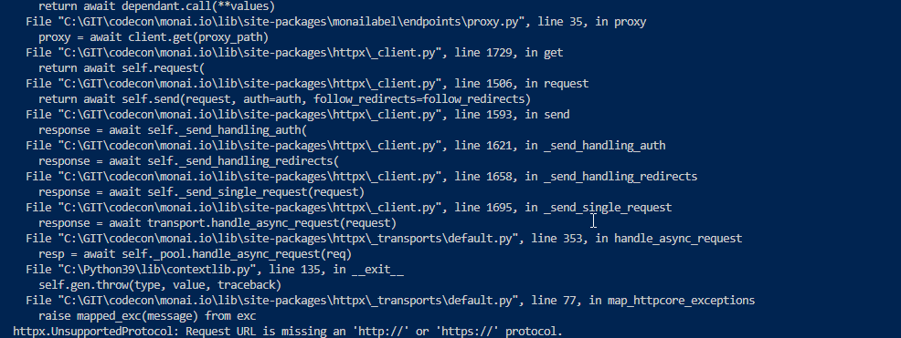
Common problems

Slide 34
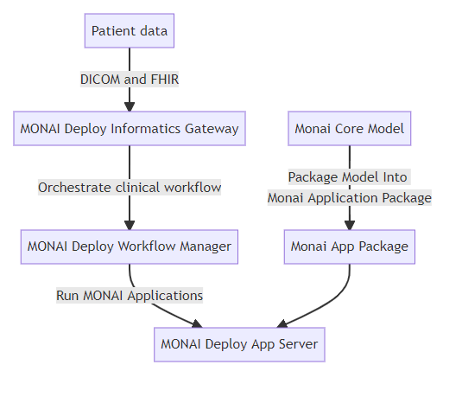
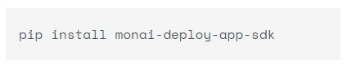
MONAI Deploy Application Workflow
MONAI Deploy

Slide 35
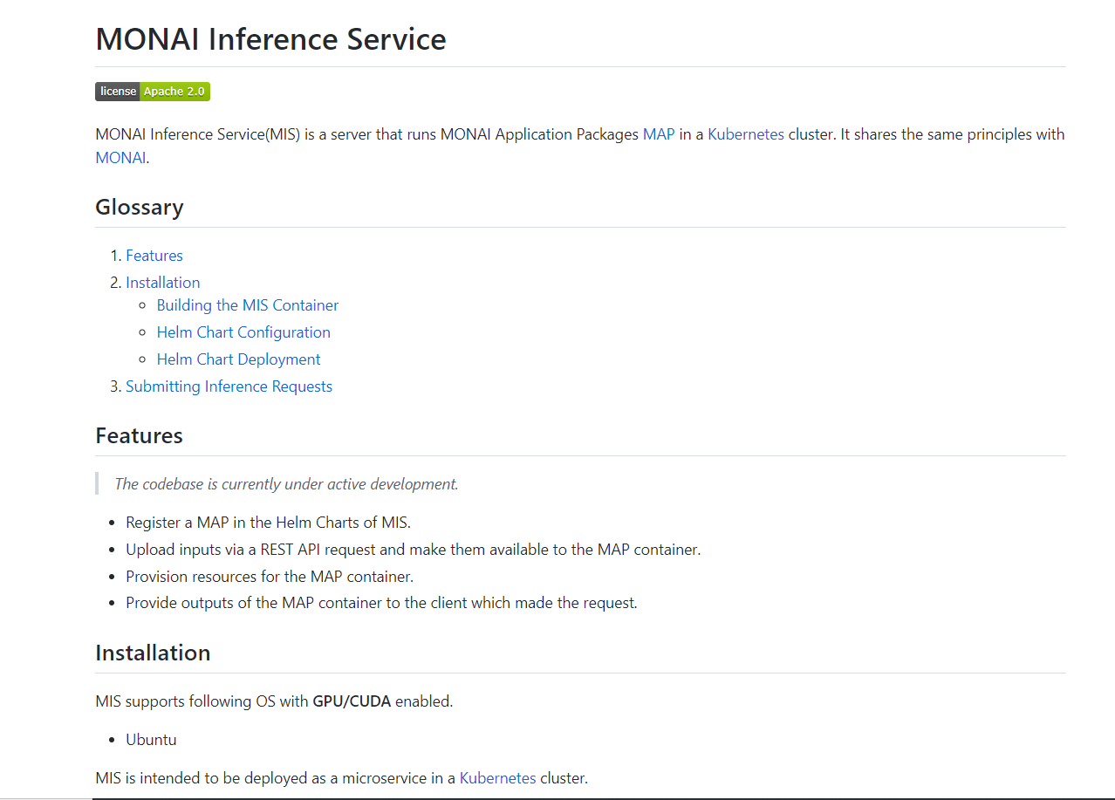

Slide 36
Machine Learning Model Reports
Ethical AI for Production

Slide 37
What is Ethical AI
Ethical AI is artificial intelligence that adheres to well-defined ethical guidelines regarding fundamental values, including such things as individual rights, privacy, non-discrimination, and non-manipulation. Ethical AI places fundamental importance on ethical considerations in determining legitimate and illegitimate uses of AI. Organizations that apply ethical AI have clearly stated policies and well-defined review processes to ensure adherence to these guidelines.

Slide 38
Examples
Google Model Cards

Slide 39
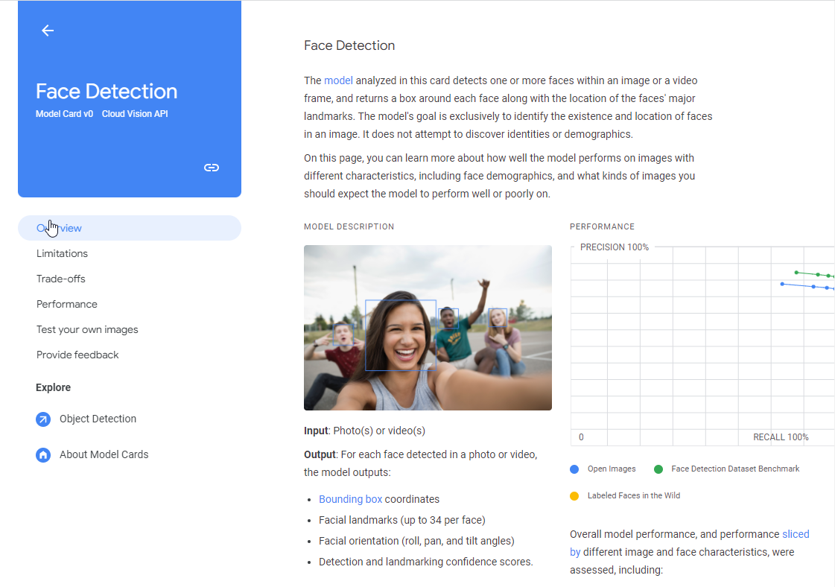

Slide 40
Examples
AI Factsheet 360

Slide 41
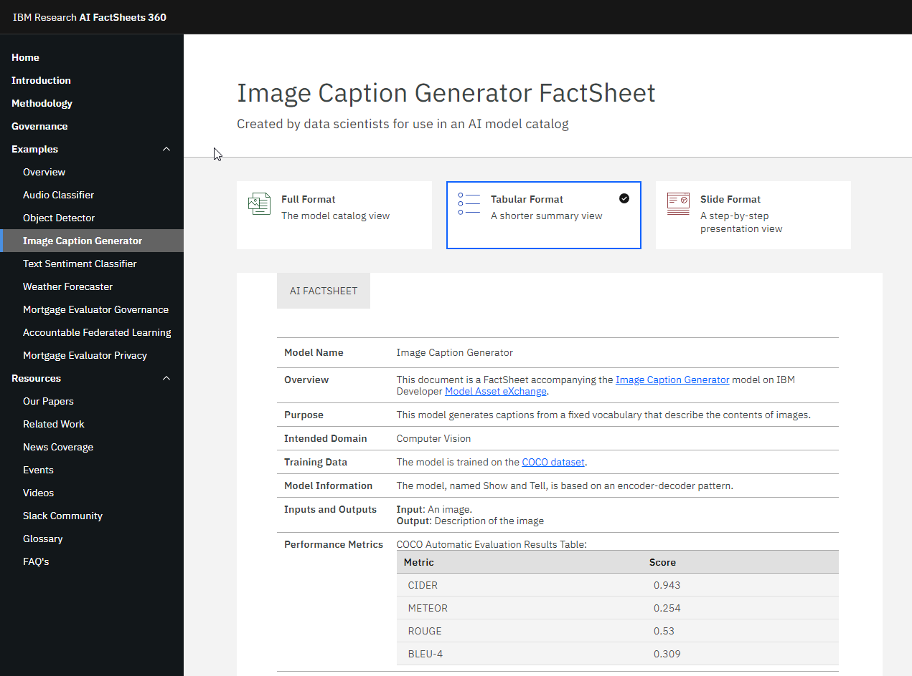

Slide 42
Examples
Verify ML

Slide 43
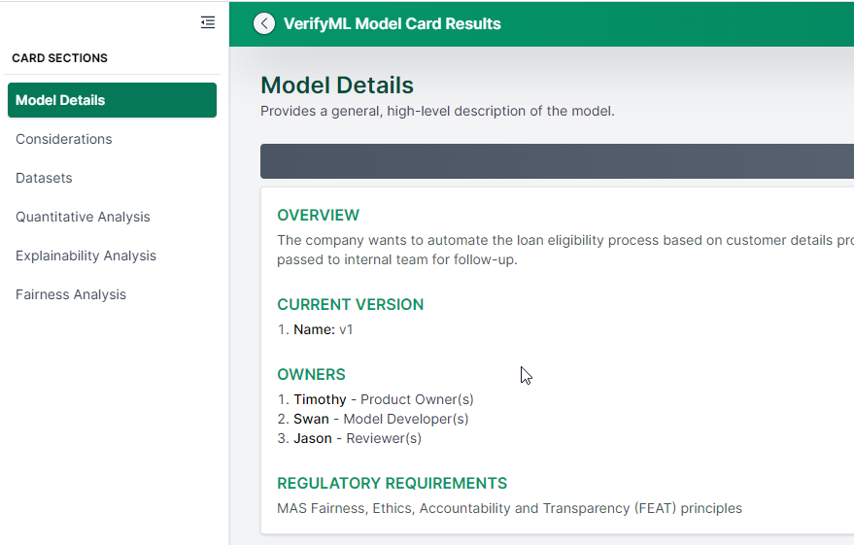

Slide 44
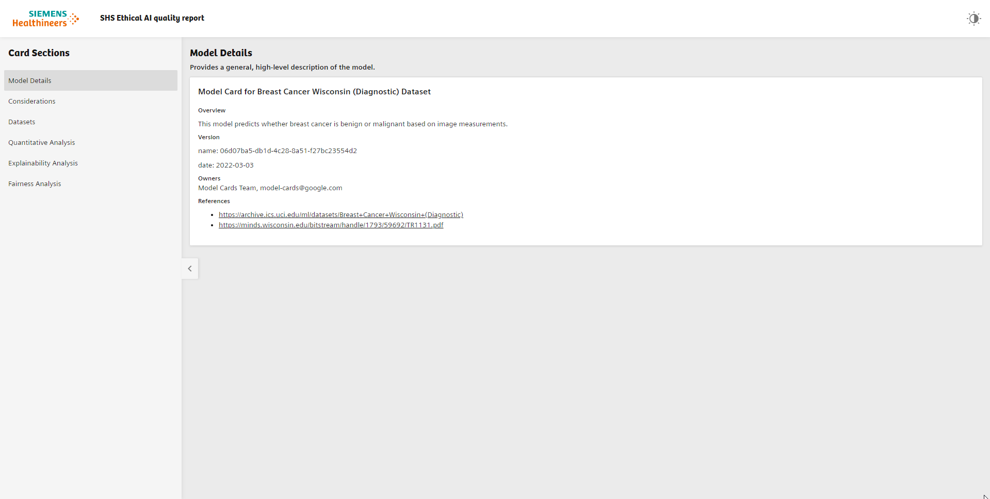
Example Implementation

Slide 45
Is use of this stuff legal, when I am already ethical?
Provide documentation,
apply for certification,
comply with regulation.

Slide 46

There are standards?
IEEE P7000™ – Standard for Model Process for Addressing Ethical Concerns During System Design
IEEE P7001™ – Standards for Transparency of Autonomous Systems
IEEE P7002™ – Standard for Data Privacy Process
IEEE P7003™ – Standard for Algorithmic Bias Considerations

Slide 47
https://github.com/johner-institut/ai-guideline
Guide for Certification of AI model

Slide 48
Contact me jan.jakubcik@siemens-healthineers.com
That’s all. Thanks for your attention.

